Slide 1
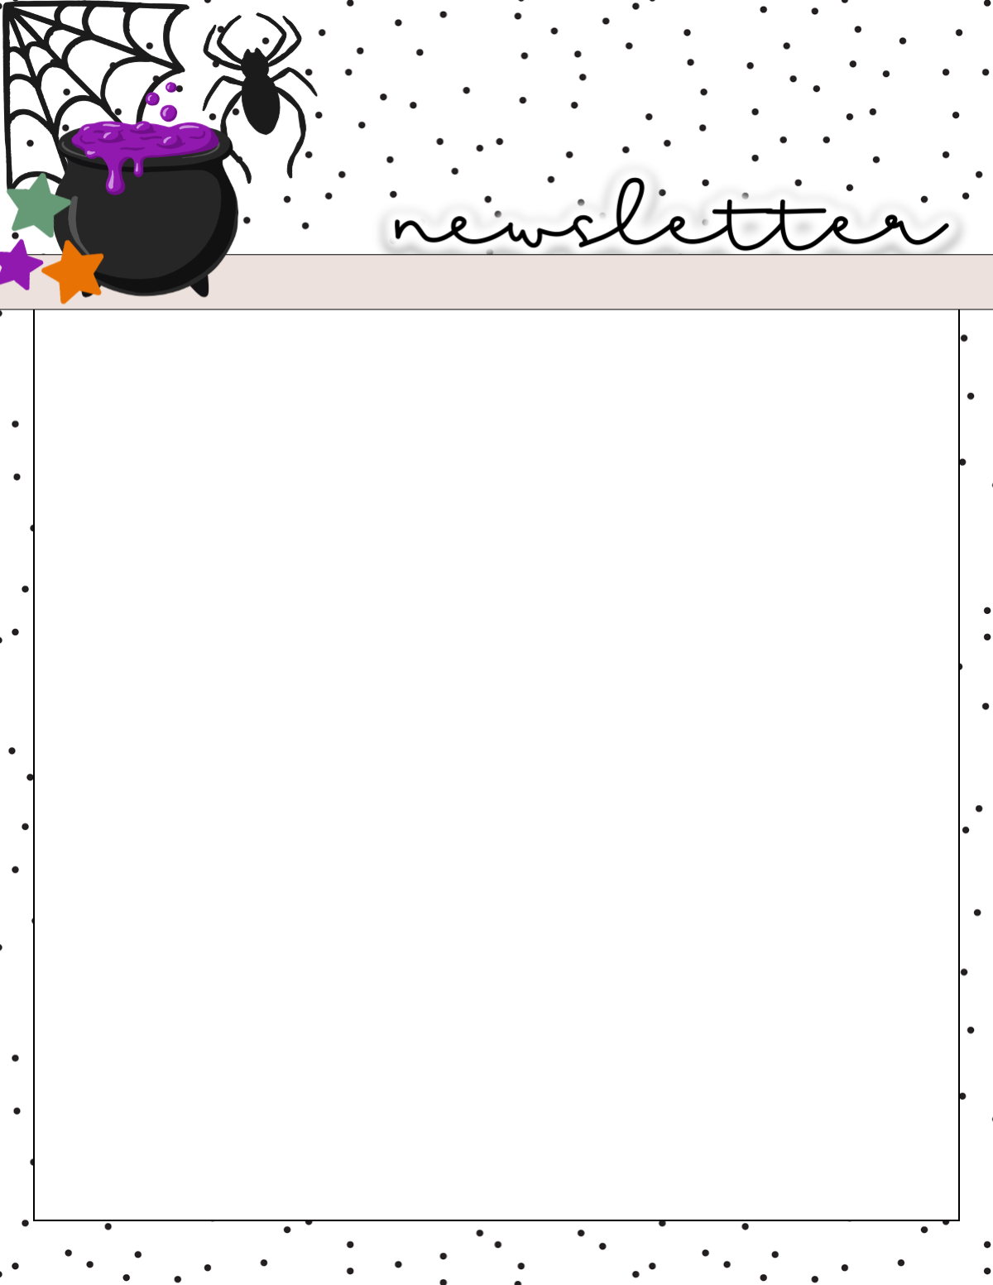
Mrs. Peacock’s
October 30-November 3, 2023
Weekly Skills
Coming up @ NSE
ELA: Connection between events
PHONICS: Long i
LANGUAGE: Verb Tenses
MATH: Subtracting 2 digit #s
SOCIAL STUDIES: People & events in the community
Nov. 3: Boosterthon Fun Run!
Nov. 7: Thanksgiving Feast @12:25
Nov. 20-24: Thanksgiving Break
Phonics Skill
Long ‘I’- I, y, igh, ie, i
Words to know:
find
pie
my
right
fry
cry
tie
mind
sigh
good
also
too
very
been
who
look
most
light
bright
trying
STUDY STUDY STUDY!
Tests this week:
Friday: Spelling
HW this week: Reading, Math, and Math Facts

